Slide 1

Fake News Detection Using NLP Techniques
A mini project utilising Python, Tkinter, and machine learning to combat misinformation in the digital age
Developed by: Anuj(24MCI10020)
Tools: Python, Tkinter, scikit-learn, WordCloud, Pandas, Matplotlib

Slide 2

The Challenge of Misinformation
Fake news has become one of the most pressing challenges in today's digital landscape, spreading rapidly across social media and online platforms. This project tackles the problem head-on by developing an intelligent system to distinguish between Real and Fake news articles.
Using advanced Natural Language Processing (NLP) techniques, the system analyses text patterns, linguistic features, and content structure to make accurate classifications.
An interactive Tkinter GUI brings the technology to life, making sophisticated machine learning accessible and visual for everyday users.

Slide 3





Project Objectives
Text Preprocessing
Feature Extraction
News Classification
Analyse and clean news articles using advanced NLP techniques to prepare data for classification
Convert raw text into machine-understandable numerical format using TF-IDF vectorisation
Train and deploy ML models to accurately classify news as Fake or Real
Visual Analytics
User Experience
Generate insightful visualisations using WordCloud and Confusion Matrix for result interpretation
Design an intuitive, interactive GUI using Tkinter for seamless user interaction

Slide 4
Technology Stack
1
2
3
Core Language
Data Processing
Machine Learning
Python — The foundation for all development, chosen for its robust ecosystem and extensive NLP support
pandas, numpy — Essential libraries for efficient data manipulation, cleaning, and structural operations
scikit-learn — Comprehensive toolkit for model training, text vectorisation, and performance evaluation
4
5
Visualisation
User Interface
wordcloud, matplotlib — Creating compelling visual representations of text patterns and model metrics
tkinter — Python's standard GUI library for building the interactive application interface

Slide 5





NLP Techniques Employed
The project leverages multiple natural language processing methods to transform raw text into meaningful insights:
Tokenisation
Stopword Removal
TF-IDF Vectorisation
Text Cleaning
Systematically breaks sentences into individual words, creating the foundation for text analysis using TF-IDF's built-in capabilities
Eliminates common words like "the", "is", and "are" that don't contribute to meaning, improving classification accuracy
Converts text into numerical feature vectors using scikit-learn, measuring word importance across documents
Combines title and content fields whilst removing noise, special characters, and inconsistencies using pandas
Visual Analysis
Generates WordClouds to highlight frequent terms in fake versus real news, revealing linguistic patterns

Slide 6
Dataset Specification
Source & Structure
Data Fields
The project utilises the fake_or_real_news.csv dataset from Kaggle, a curated collection specifically designed for training fake news detection models.
id
Unique identifier for each news article entry
6.3K
4
title
Total Articles
Key Columns
The headline or main title of the news article
Balanced dataset for robust training
Structured data fields
text
Full body content of the news article
label
Ground truth classification: "FAKE" or "REAL"

Slide 7








Development Workflow
Data Loading & Cleaning
Import the dataset and perform initial preprocessing to remove inconsistencies and prepare for analysis
Feature Engineering
Combine title and text fields to create comprehensive content for analysis
TF-IDF Transformation
Apply Term Frequency-Inverse Document Frequency vectorisation to convert text into numerical features
Data Splitting
Divide dataset into training (80%) and testing (20%) sets for model validation
Model Training
Train the PassiveAggressiveClassifier on vectorised training data
Classification & Prediction
Deploy trained model to predict whether news articles are Fake or Real
Performance Visualisation
Generate accuracy metrics, confusion matrices, and word clouds for insight
GUI Development
Build interactive Tkinter interface for user-friendly news article input and classification

Slide 8
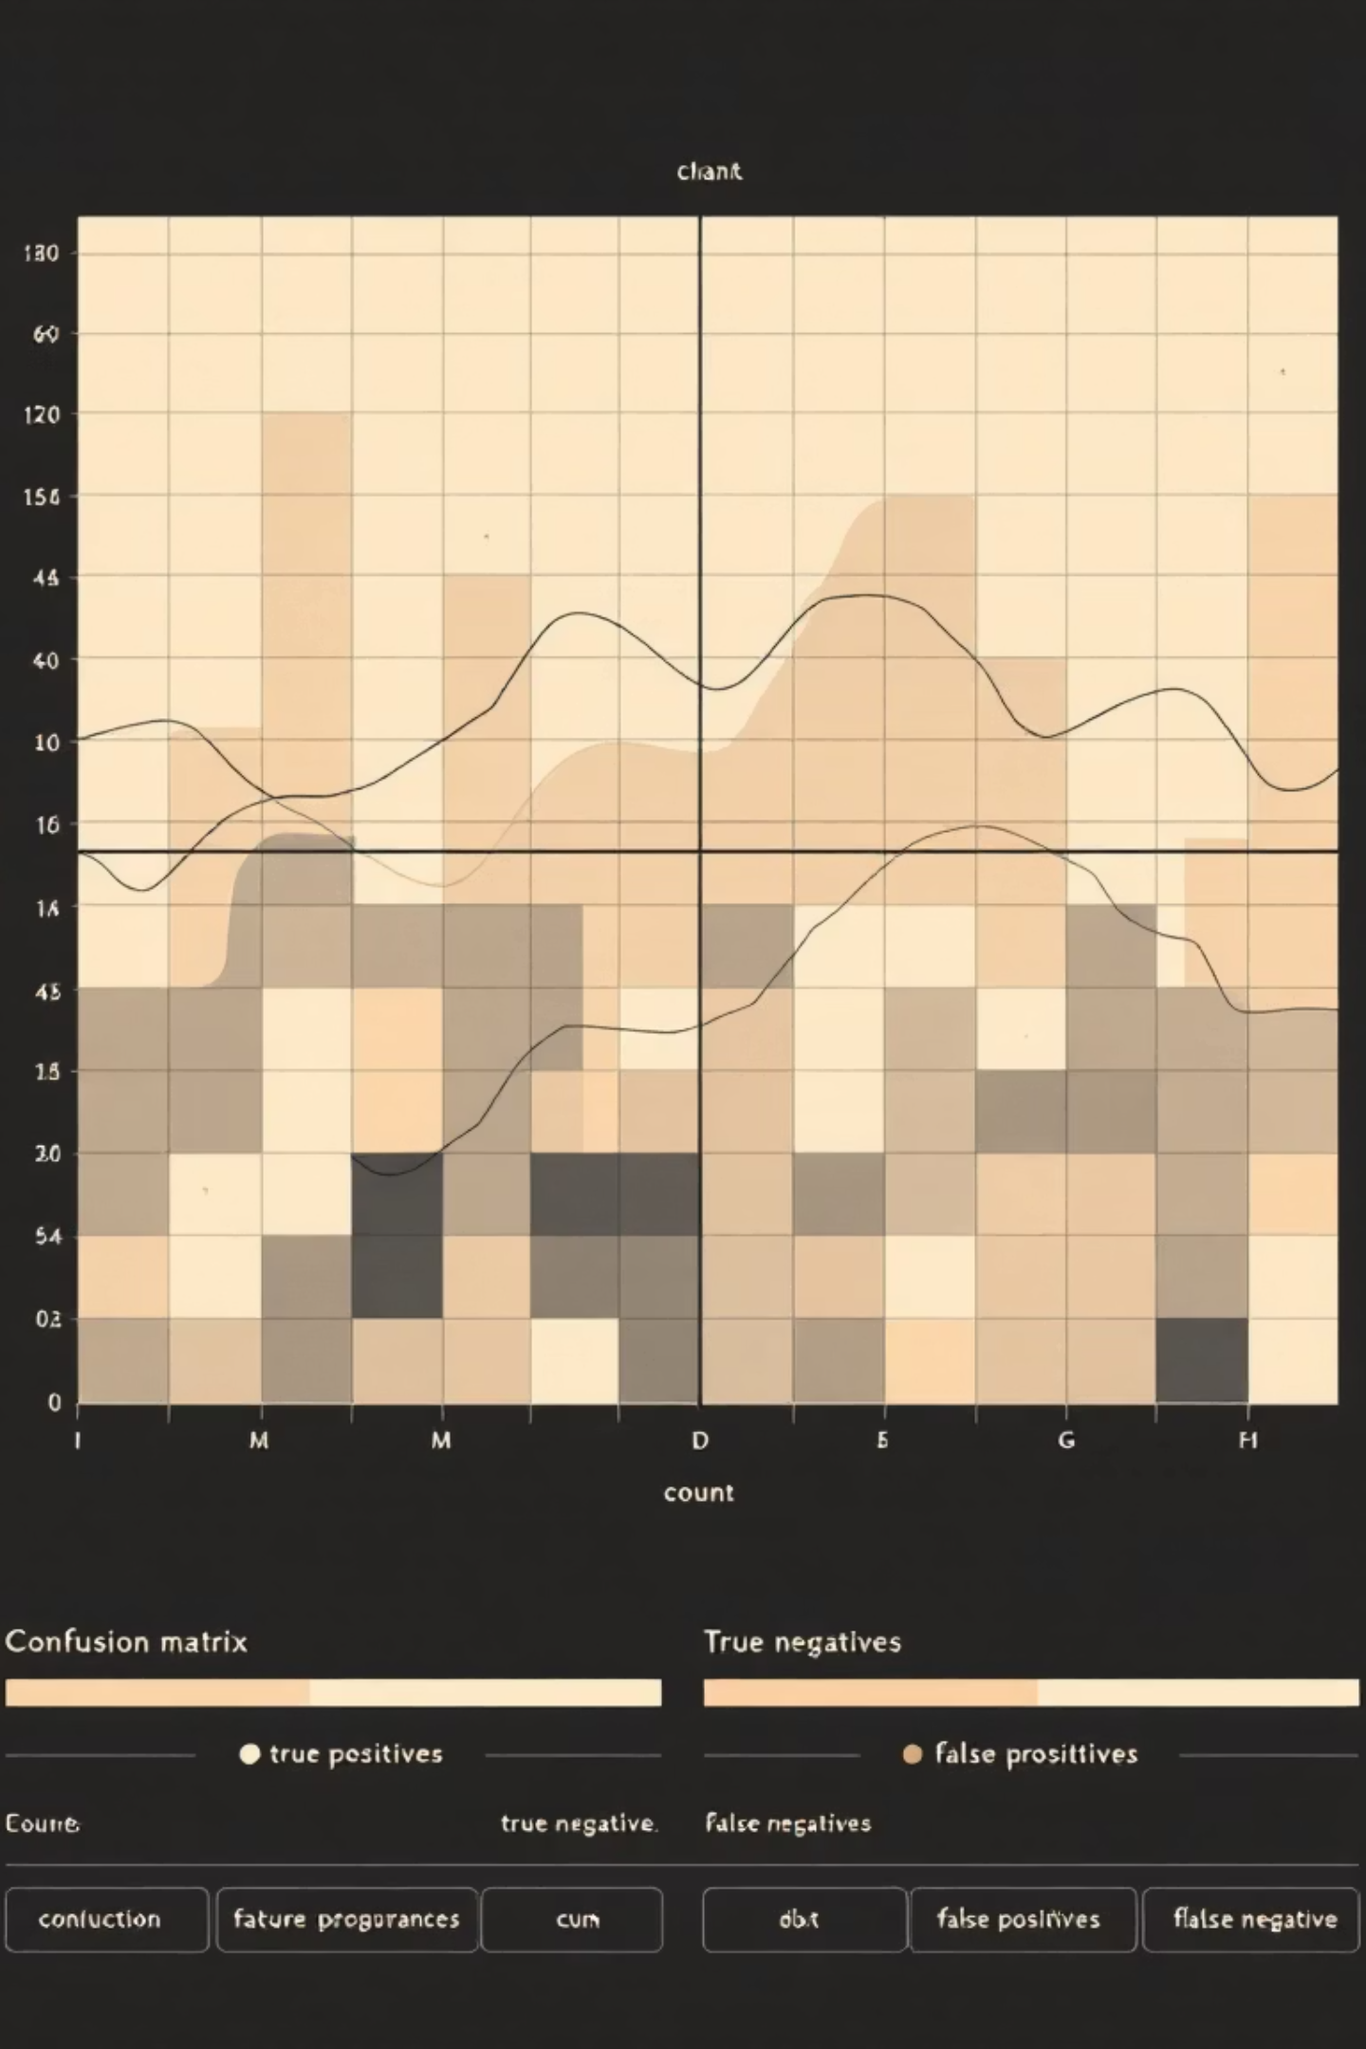


Model Performance
PassiveAggressiveClassifier
The project employs the PassiveAggressiveClassifier, an online learning algorithm particularly effective for large-scale text classification tasks.
94%
Why this model?
Efficient for streaming and online learning scenarios
Excellent performance on high-dimensional sparse data
Model Accuracy
Adapts aggressively to misclassified examples whilst remaining passive for correctly classified ones
Achieved on test dataset
Evaluation Methodology
Computationally efficient for text classification problems
Performance assessed using Confusion Matrix analysis, providing detailed insights into true positives, false positives, true negatives, and false negatives across both fake and real news classifications.

Slide 9



Visual Insights
The project generates multiple visualisation layers to understand classification patterns and model behaviour:
WordCloud Analysis
Confusion Matrix
Interactive GUI Output
Fake News WordClouds reveal dominant sensationalist terms, emotionally charged language, and clickbait patterns
Provides a comprehensive graphical representation of model accuracy, displaying:
The Tkinter interface displays classification results with clear visual indicators:
Real News WordClouds showcase factual terminology, proper nouns, and informative vocabulary
True Positives & True Negatives
🚫 FAKE — Article flagged as misinformation
False Positives & False Negatives
✅ REAL — Article verified as credible
These visualisations expose the linguistic fingerprints that distinguish credible journalism from misinformation
Overall classification distribution

Slide 10




Conclusion & Future Directions
Key Achievements
Future Enhancements
Successfully developed an NLP-based fake news detection system using Python
Advanced Models
Implement deep learning architectures like LSTM or BERT for improved contextual understanding
Integrated multiple technologies into a cohesive solution
Real-Time Integration
Achieved 94% classification accuracy
Connect to news APIs for live article analysis and continuous monitoring
Demonstrating robust performance on real-world data
Web Deployment
Created an accessible user interface
Transform into a scalable web application accessible to broader audiences
Combining ML, GUI, and visualisation for enhanced interaction

